Slide 1
Room part 2
Week 9
Advanced Native Mobile Programming
Teknik Informatika - Universitas Surabaya

Slide 2
0.
The Concept

Slide 3
Database Migration
Database migration is the process of migrating data from one or more source databases to one or more target databases by using a database migration service.
The Room persistence library supports incremental migrations with the Migration class to address this need

Slide 4
How Migration Works
Version 1 User { id:Int, name:String, }
Version 2 User { id: Int, name:String, email:String }
Version 3 User { id: int, name:String, email:String, password:String }
At first installation app will execute migration incrementally starting from 1 to 2 and finally 2 to 3.

Slide 5
Migration Class
Each Migration subclass defines a migration path between a startVersion and an endVersion by overriding the Migration.migrate() method.
val MIGRATION_1_2 = object : Migration(1, 2) {
override fun migrate(database: SupportSQLiteDatabase) {
database.execSQL
("ALTER TABLE user ADD COLUMN email TEXT")
}
}
val MIGRATION_2_3 = object : Migration(2, 3) {
override fun migrate(database: SupportSQLiteDatabase) {
database.execSQL
("ALTER TABLE user ADD COLUMN password TEXT")
}
}

Slide 6
Migration Class
Room can handle more than one version increment: we can define a migration that goes from version 1 to 3 in a single step, making the migration process faster.
val MIGRATION_1_3 = object : Migration(1, 3) {
override fun migrate(database: SupportSQLiteDatabase) {
database.execSQL
("ALTER TABLE user ADD COLUMN email TEXT")
database.execSQL
("ALTER TABLE user ADD COLUMN password TEXT")
}
}
Room.databaseBuilder(applicationContext, MyDb::class.java, "database-name") .addMigrations(MIGRATION_1_2, MIGRATION_2_3, MIGRATION_1_3).build()
Add the migration to the Room database builder

Slide 7
Destructive Migration
In some cases, migrations is not needed and its okay to clear all record from the database during the upgrade version, then you may call fallbackToDestructiveMigration in the database builder:
val db= Room.databaseBuilder(context.getApplicationContext(),
MyDb.class, "database-name")
.fallbackToDestructiveMigration()
.build();

Slide 8
Auto Migration
Starting from Room 2.4.0-alpha01, we can also use auto migration when the changes are simple (e.g. adding new column to an existing table)
Read more: https://medium.com/androiddevelopers/room-auto-migrations-d5370b0ca6eb

Slide 9
1.
Utility

Slide 10

Utility Package
The building database methods have been placed in a different location. It'd be better if we centralized that method within a single function in the utility file.
Create new package > util
Create new file, name it Util.kt and put it under the package

Slide 11
Util
buildDB
This is the same function that use to gain access to DB resources. It requires context and returns the TodoDatabase DB object.
val DB_NAME = "newtododb"
fun buildDb(context: Context):TodoDatabase {
val db = Room.databaseBuilder(context, TodoDatabase::class.java, DB_NAME)
.build()
return db
}

Slide 12
Call buildDb in ViewModel
Next, check all ViewModel (DetailTodoViewModel & ListTodoViewModel) class and replace the previous hardcoded build database function with the buildDb method from Util val db = buildDb(getApplication())

Slide 13
Create Soft Back Button
Next, setup the main activity to show soft back button when needed.
private lateinit var navController: NavController override fun onCreate(savedInstanceState: Bundle?) {
. . .
navController = (supportFragmentManager.findFragmentById(R.id.fragmentHost) as NavHostFragment).navController
NavigationUI.setupActionBarWithNavController(this, navController) } override fun onSupportNavigateUp(): Boolean {
return NavigationUI.navigateUp(navController,null)
}

Slide 14
2.
The Layout

Slide 15
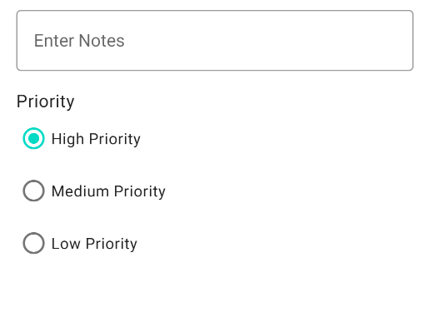
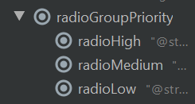
Add Priority Radio Button
Open the Create Todo Fragment layout:
Add Radio Group
Add three Radio Button into Radio Group
Name the RadioGroup id as “radioGroupPriority”
Name each radio button id as “radioHigh”, “radioMedium”, and “radioLow” respectively from top to bottom

Slide 16

Set Tag Value
Each radio button can have a tag value. It's handy to set a value for each radio button
radioHigh, set tag to 3
radioMedium, set tag to 2
radioLow, set tag to 1
This value is used to set todo priority. A high number means high priority.

Slide 17
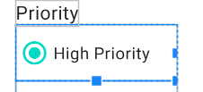

Default Selected Radio Button
Click on Radio button High Priority and set checked to true. Therefore this radio button is selected as default.

Slide 18
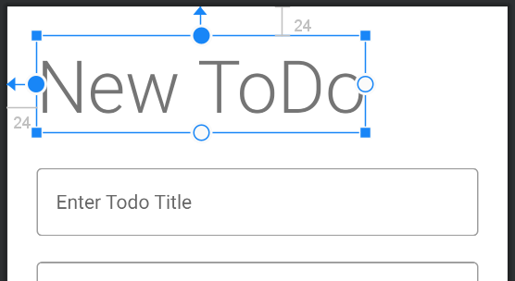
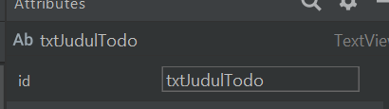
Set Id for Todo Header Titler
Click on new todo Header
Set ID
By setting the id for this textview, it can be changed programmatically. It’ll be coming in handy later.

Slide 19
Create New Fragment
Next, create a new Edit Fragment to edit the todo data.
Name it as “EditTodoFragment”
Since this fragment will reuse the same layout from Create Todo Fragment, you may delete the fragment_edit_todo.xml

Slide 20
CleanUp Codes
As usual, delete everything in EditTodoFragment except onCreateView
Override the onViewCreated
override fun onViewCreated(view: View, savedInstanceState: Bundle?) {
super.onViewCreated(view, savedInstanceState)
}

Slide 21
The Navigation Graph
This new fragment is a new destination reachable from the TodoListFragment
User may click on pencil edit button to edit particular todo
Open the navigation_main.xml

Slide 22
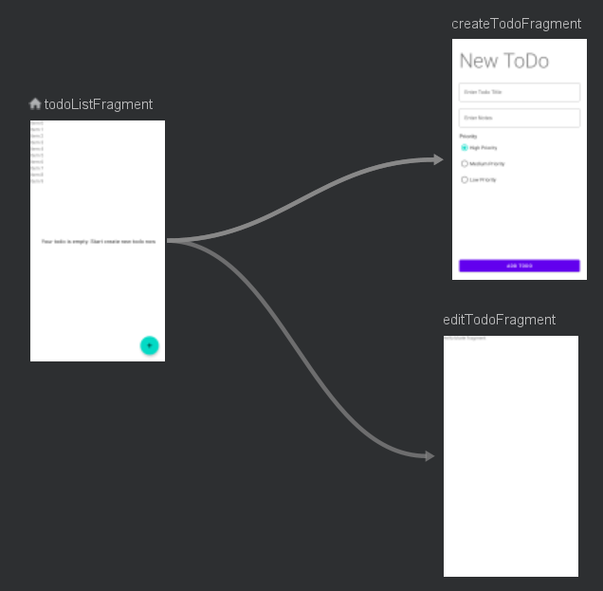

The Navigation Graph
1. New destination
Add the editTodoFragment, and set action (connection) from todoListFragment.
2. Add Argument
Click the editTodoFragment, and then add “uuid” (integer) argument. This argument used to load particular todo data in Edit Todo Fragmnt
3. Action
Click on the arrow, name it as “actionEditTodoFragment”. Set proper fadeIn and fadeOut anim

Slide 23
Call The Navigation
Don’t forget to rebuild the project, to apply the changes of Navigation Graph
Next, call the navigation action from the adapter
Open the TodoListAdapter

Slide 24
Call The Navigation
Edit Listener
This code is used to setup the listener whenever user clicks on pencil edit button. It navigates to Edit Todo Fragment
Notice that it also passes the argument of selected uuid
holder.view.imgEdit.setOnClickListener {
val action =
TodoListFragmentDirections.actionEditTodoFragment(todoList[position].uuid)
Navigation.findNavController(it).navigate(action)
}
holder.view.checkTask.setOnCheckedChangeListener { compoundButton, isChecked ->
if(isChecked == true) {
adapterOnClick(todoList[position])
}
}
Check Task
Make little adjustments for check task listener. Now if the task is checked, then it should be removed from database

Slide 25
The ViewModel
Remember, there is no LiveData variable in the DetailTodoViewModel. Next step is to create new one (it will be used by Edit Todo Fragment).
Open the DetailTodoViewModel.kt
Add the Live Data variable val todoLD = MutableLiveData<Todo>()

Slide 26
The ViewModel
Add fetch function with uuid as parameter
fun fetch(uuid:Int) {
launch {
val db = buildDb(getApplication())
todoLD.value = db.todoDao().selectTodo(uuid)
}
}
Select Todo
This fetch function use selectTodo from DAO. This will load a single Todo and returns it.

Slide 27
The ViewModel
The Edit Todo fragment requires the same ViewModel that being used by the CreateTodoFragment
Open the EditTodoFragment.kt
Create the viewmodel variable private lateinit var viewModel: DetailTodoViewModel
Intialize the viewmodel in onViewCreated
override fun onViewCreated(view: View, savedInstanceState: Bundle?) {
super.onViewCreated(view, savedInstanceState)
viewModel = ViewModelProvider(this).get(DetailTodoViewModel::class.java)
}

Slide 28
Rename the Title and Button Add
Remember, this fragment uses the same layout from Create Todo. Therefore the title needs to be adjusted properly. Add following codes inside onViewCreated:
txtJudulTodo.text = "Edit Todo"
btnAdd.text = "Save Changes"

Slide 29
Load the Data
viewModel = ViewModelProvider(this).get(DetailTodoViewModel::class.java)
val uuid = EditTodoFragmentArgs.fromBundle(requireArguments()).uuid
viewModel.fetch(uuid)
observeViewModel()
1. Read UUID
First, it read argument send from the Adapter
2. Fetch
Second, it called fetch from live model with uuid supplied as parameter
3. Observe
Finally, observe the live data (todo)

Slide 30
Observe Method
fun observeViewModel() {
viewModel.todoLD.observe(viewLifecycleOwner, Observer {
txtTitle.setText(it.title)
txtNotes.setText(it.notes)
})
}
Populate
Show the loaded Todo into edit text title and notes

Slide 31
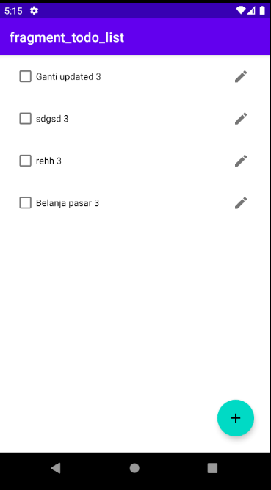
Result
Click on Edit Button

Slide 32
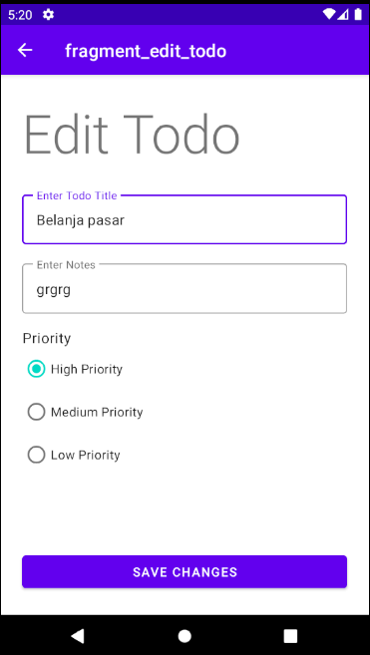
Result
Data loaded in Edit Fragment

Slide 33
3.
The Model

Slide 34
Priority Field
The todo model must be altered to provide a priority value that indicates how important the todo is:
Open the model.kt
Add the priority (int), see next slide

Slide 35
Priority Field
@Entity
data class Todo(
@ColumnInfo(name="title")
var title:String,
@ColumnInfo(name="notes")
var notes:String,
@ColumnInfo(name="priority")
var priority:Int
) {
@PrimaryKey(autoGenerate = true)
var uuid:Int =0
}

Slide 36
Update the DAO
Users may edit the todo after it is created. Therefore inside the DAO, add the update query for todo data.
@Query("UPDATE todo SET title=:title, notes=:notes, priority=:priority
WHERE uuid = :id")
suspend fun update(title:String, notes:String, priority:Int, id:Int)
priority
Notice that priority field have been added here.

Slide 37
4.
Database Migration

Slide 38
Database Migration
Because there is changes on the Todo Table (we add priority field), therefore it needs to define migration policy. So you need to do three things:
Define Migration Policy (method)
Increase Database Version by 1
Add the migration method into the database builder function

Slide 39
Define Migration Policy (method)
Open the util.kt. Add this migration method:
val MIGRATION_1_2 = object : Migration(1, 2) {
override fun migrate(database: SupportSQLiteDatabase) {
database.execSQL(
"ALTER TABLE todo ADD COLUMN priority INTEGER DEFAULT 3 not null")
}
}
MIGRATION_1_2
It means this migration is used for upgrading the db from version 1 to 2
ALTER QUERY
New priority column added. Integer type. And because its must have value (see the model), we add the “DEFAULT 3 not null”. Default 3 means that this priority will be set to 3 for the old data.

Slide 40
Increase Database Version by 1
Version 2
Increase database version by 1, every time you change the data scheme
Open the TodoDatabase.kt:
@Database(entities = arrayOf(Todo::class), version = 2)
abstract class TodoDatabase:RoomDatabase() {
. . .
companion object {
. . .
}

Slide 41
Add the migration method into the database builder function
Open the TodoDatabase.kt:
companion object {
. . .
private fun buildDatabase(context:Context) = Room.databaseBuilder(
context.applicationContext,
TodoDatabase::class.java, "newtododb")
.addMigrations(MIGRATION_1_2)
.build()
}
Add Migration Policy
Add all migration policies into the builder (separate with comma).

Slide 42
Add the migration method into the database builder function
Open the Util.kt:
fun buildDb(context: Context):TodoDatabase {
val db = Room.databaseBuilder(context,
TodoDatabase::class.java, DB_NAME)
.addMigrations(MIGRATION_1_2)
.build()
return db
}
Add Migration Policy
Add all migration policies into the builder (separate with comma).

Slide 43
5.
Fix The Create & Edit Todo

Slide 44
Fix the Create Todo
Open the CreateTodoFragment.kt
Look for the error. It should be inside the btnAdd listener. Because the Todo class now requires the “priority” field

Slide 45
Fix the Create Todo
Get The Radio
First get access to Radio Group priority by findViewByID function
Next get access to the selected radio button (high, medium, or low)
btnAdd.setOnClickListener {
var radio =
view.findViewById<RadioButton>(radioGroupPriority.checkedRadioButtonId)
var todo = Todo(txtTitle.text.toString(),
txtNotes.text.toString(), radio.tag.toString().toInt())
val list = listOf(todo)
. . .
Retrieve Tag value
Radio object now contain the selected radio button. Use the tag value to retrieve the priority number (3, 2, or 1)
Then store it inside the Todo object

Slide 46
Fix The Edit Todo
Open the EditTodoFragment. Look for the ObserveViewModel method
fun observeViewModel() {
viewModel.todoLD.observe(viewLifecycleOwner, Observer {
. . .
when (it.priority) {
1 -> radioLow.isChecked = true
2 -> radioMedium.isChecked = true
else -> radioHigh.isChecked = true
}
})
}
Populate The Radio
Based on priority field, select the appropriate Radio button

Slide 47
Save Changes
Open the DetailTodoViewModel.kt add following method:
fun update(title:String, notes:String, priority:Int, uuid:Int) {
launch {
val db = buildDB(getApplication())
db.todoDao().update(title, notes, priority, uuid)
}
}
Save Todo Changes
This function is used to update current todo based on its uuid

Slide 48
Save Changes
Go back to EditTodoFragment. Add btnCreateTodo listener to execute update query on Todo:
btnCreateTodo.setOnClickListener {
val radio =
view.findViewById<RadioButton>(radioGroupPriority.checkedRadioButtonId)
viewModel.update(txtTitle.text.toString(), txtNotes.text.toString(),
radio.tag.toString().toInt(), uuid)
Toast.makeText(view.context, "Todo updated", Toast.LENGTH_SHORT).show()
Navigation.findNavController(it).popBackStack()
}

Slide 49
6.
Fix The Priority Order in TodoList

Slide 50
Fix The Priority Order in TodoList
High priority task should be displayed on top of list and lowest priority should be placed on the bottom
To accomplish this, simply adjust the select query with “ORDER” command
Open the todo DAO, add the ORDER command
@Query("SELECT * FROM todo ORDER BY priority DESC")
suspend fun selectAllTodo(): List<Todo>

Slide 51
Result
Try to create multiple todo with different priority
Try to edit some todos
Try to delete the todos

Slide 52
7.
Homework

Slide 53
Homework
Alter the Todo table by adding a new field:
is_done
INTEGER
Default value is 0 and not null
Every time user checks the task, update the todo "is_done" field from 0 to 1. Do not delete the todo. Moreover, only is_done = 0 that displayed on the list.

Slide 54
INTEGER
Why this is_done field use INTEGER instead of BOOLEAN?
Answer by adding comments on the line where you altered the table, something like this:
[your modification here] // because …

Slide 55
Submission
Do the commit and push on the github
Set your github project url to public
Submit the github project url to ULS
Due date is next week

Slide 56
Thanks!
Any questions?
You can reach me at:
andre@staff.ubaya.ac.id

